Slide 1
ECE 471/571 – Lecture 11
Nonparametric Density Estimation – k-nearest neighbor (kNN)
10/01/13

Slide 2
Different Approaches - More Detail
Pattern Classification
Statistical Approach
Syntactic Approach
Supervised
Unsupervised
Basic concepts:
Baysian decision rule
(MPP, LR, Discri.)
Basic concepts:
Distance
Agglomerative method
Parametric learning (ML, BL)
k-means
Non-Parametric learning (kNN)
Winner-take-all
NN (Perceptron, BP)
Kohonen maps
Dimensionality Reduction
Fisher’s linear discriminant
K-L transform (PCA)
Performance Evaluation
ROC curve
TP, TN, FN, FP
Stochastic Methods
local optimization (GD)
global optimization (SA, GA)
ECE471/571, Hairong Qi

Slide 3
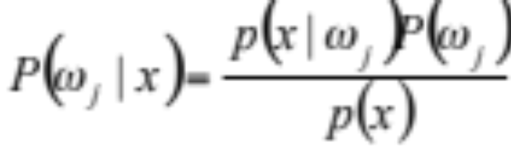
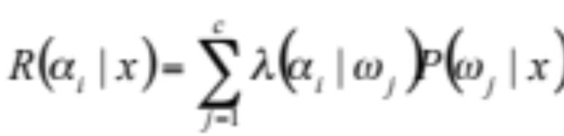

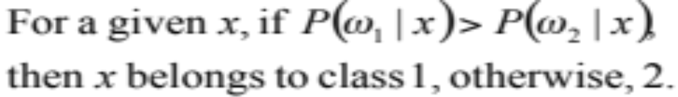
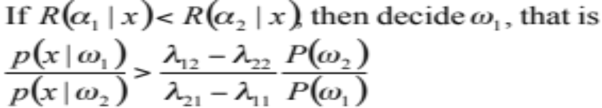
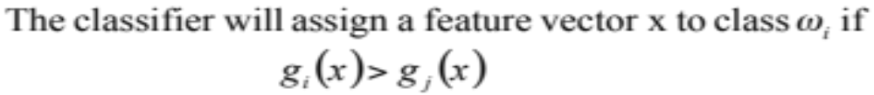
Bayes Decision Rule (Recap)
Maximum
Posterior
Probability
Likelihood Ratio
Discriminant
Function
Three cases
Estimate Gaussian, Two-modal Gaussian
Dimensionality reduction
Performance evaluation and ROC curve

Slide 4

Motivation
Estimate the density functions without the assumption that the pdf has a particular form

Slide 5
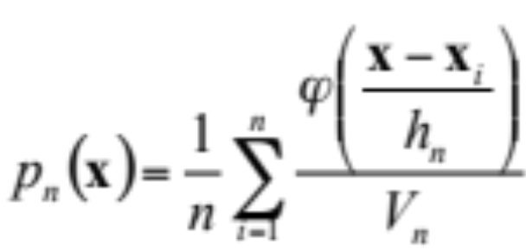
*Problem with Parzen Windows
Discontinuous window function -> Gaussian
The choice of h
Still another one: fixed volume

Slide 6
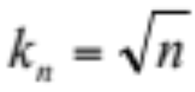
kNN (k-Nearest Neighbor)
To estimate p(x) from n samples, we can center a cell at x and let it grow until it contains k_{n} samples, and k_{n} can be some function of n
Normally, we let

Slide 7
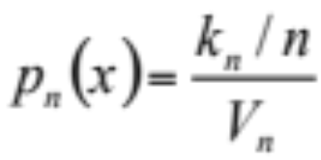
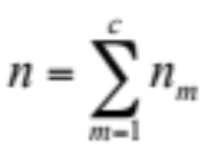
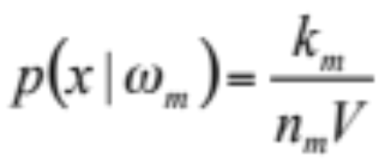
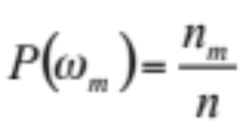
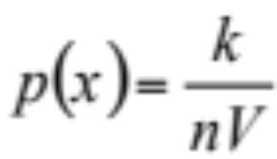
kNN in Classification
Given c training sets from c classes, the total number of samples is
*Given a point x at which we wish to determine the statistics, we find the hypersphere of volume V which just encloses k points from the combined set. If within that volume, k_{m} of those points belong to class m, then we estimate the density for class m by

Slide 8
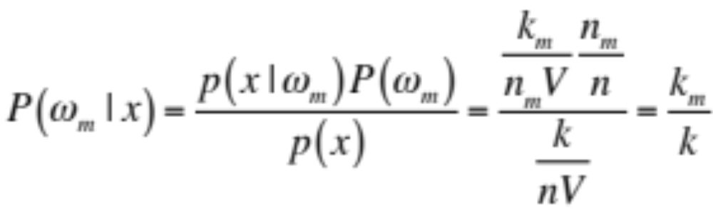
kNN Classification Rule
The decision rule tells us to look in a neighborhood of the unknown feature vector for k samples. If within that neighborhood, more samples lie in class i than any other class, we assign the unknown as belonging to class i.

Slide 9
Problems
What kind of distance should be used to measure “nearest”
  Euclidean metric is a reasonable measurement
Computation burden
  Massive storage burden
  Need to compute the distance from the unknown to all the neighbors

Slide 10
Computational Complexity of kNN
In both space (storage space) and time (search time)
Algorithms reducing the computational burden
  Computing partial distances
  Prestructuring
  Editing the stored prototypes

Slide 11
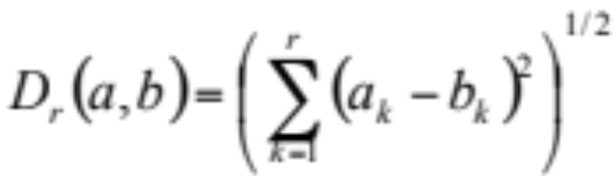
Method 1 - Partial Distance
Calculate the distance using some subset r of the full d dimensions. If this partial distance is too large, we don’t need to compute further
What we know about the subspace is indicative of the full space

Slide 12
Method 2 - Prestructuring
Prestructure samples in the training set into a search tree where samples are selectively linked
Distances are calculated between the testing sample and a few stored “root” samples, and then consider only the samples linked to it
Closest distance no longer guaranteed.
X x o o
x x o o
X x x o o
x x x x

Slide 13
Method 3 – Editing/Pruning/Condensing
Eliminate “useless” samples during training
  For example, eliminate samples that are surrounded by training points of the same category label
Leave the decision boundaries unchanged

Slide 14
Discussion
Combining three methods
Other concerns
  The choice of k
  The choice of metrics

Slide 15
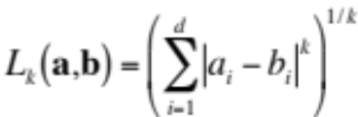
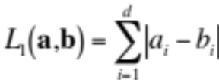
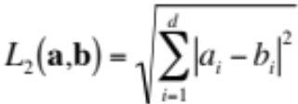
Distance (Metrics) Used by kNN
Properties of metrics
  Nonnegativity (D(a,b) >=0)
  Reflexivity (D(a,b) = 0 iff a=b)
  Symmetry (D(a,b) = D(b,a))
  Triangle inequality (D(a,b) + D(b,c) >= D(a,c))
Different metrics
  Minkowski metric
    Manhattan distance (city block distance)
    Euclidean distance
    When k is inf, maximum of the projected distances onto each of the d coordinate axes

Slide 16
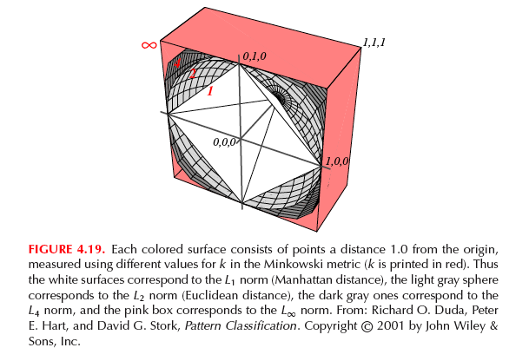
Visualizing the Distances

